Slide 1


Portable Plant Monitor System
Group 4
Alexander Meade: CpE
Syed Bukhari: EE
Nicholas Poidomani: CpE
Kareem Rahounji: EE
Notes:
Alec

Slide 2
Motivation
Create an environment to monitor plant growth and easily transport it
Provide researchers controlled environments to study plant life
Ability to move the environment without stress to the plant
Notes:
Alec

Slide 3
Goals and Objectives
Primary Goals
Provide monitoring for plant growth
Make the environment portable
Switch between battery and AC power
Secondary Goals
Low power consumption
Exchangeable batteries
Low cost assembly

Slide 4
Specifications
Project Area | Design Specification
Temperature Monitoring | Be able to monitor temperatures from 20°C to 40°C
Humidity Monitoring | Be able to monitor up to 70% humidity
Battery Life | Run off battery for a minimum of 2 hours
Portability/Weight | Weight less than 20lbs
Portability/Size | Dimensions within 2ft x 2ft x 3ft dimension (LxWxH)
Notes:
Syed

Slide 5
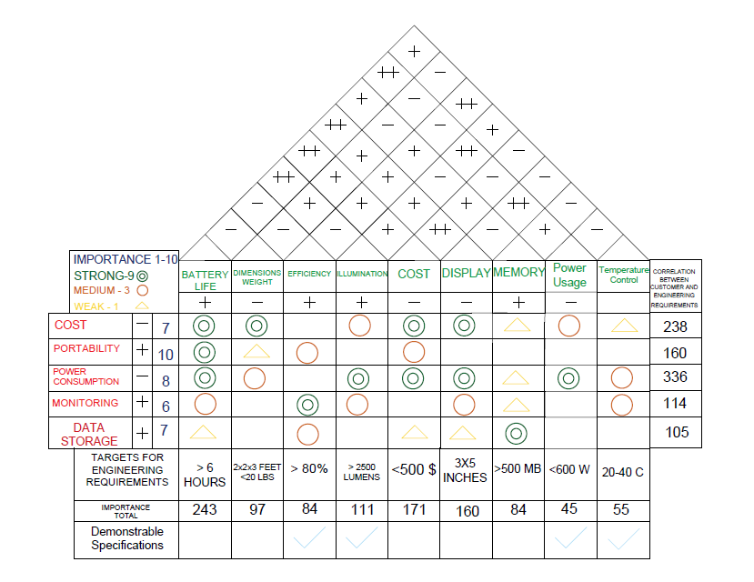
House
of
Quality
Notes:
Syed

Slide 6
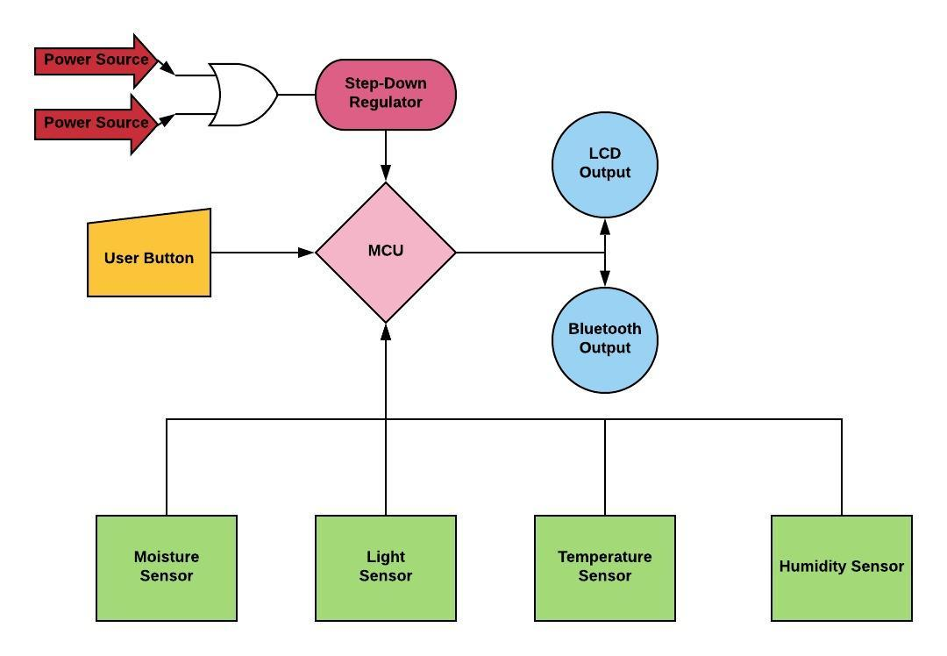
Electrical System Diagram

Slide 7
Project Design
Notes:
Nick

Slide 8
Requirements for CPU
Need a CPU with ability to drive the sensors and communication
Still want to keep power consumption low
Desire for ease of integration of all parts
Potential to expand the scope of sensors used

Slide 9
CPU Comparisons
 | Atmega 2560 | PIC24FJ128GA010 | ESP8266 | TI MSP430G2xx
Architecture | 8 Bit | 16 Bit | 32 Bit | 16 Bit
Program Memory | 256kB | 128kB | 1MB | 128kB
SRAM | 8kB | 8Kb | 80kB | 4kB
Clock Speed | 16MHz | 32MHz | 80MHz | 16MHz
EEPROM | 4kB | 64kB | 80kB | 56kB
Number of Timers | 6 | 5 | 1 | 2
JTAG Support | Yes | No | No | Yes
GPIOs | 86 | 100 | 16 | 32
Community Support | Abundant | Minimal | Adequate | Adequate

Slide 10
MCU Decision
Choice - Atmega 2560
Reasons:
Ease of flashing code into the MCU
Better integration into our PCB due to documentation
Tradeoffs:
Loss of some internal modules
More limited CPU and memory resources
Limited file handling
Notes:
Nick

Slide 11

Potential Environment Sensors
Many sensor options but we want the most relevant to growth
Soil Moisture
Humidity
Barometer
Temperature
Light Level
Soil Nutrient
Accelerometer

Slide 12
Sensor Type Selection
Soil Moisture
Dry soil can cause malnutrition
Light
Light is critical to all plant life
Temperature and Humidity
Extreme conditions can be damaging to plant growth

Slide 13
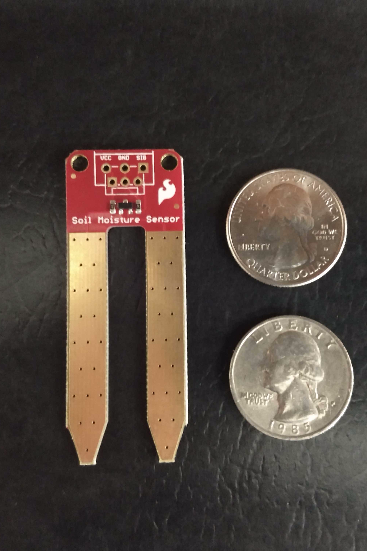
Soil Moisture Sensor SEN-13322
Low cost
High accuracy
Simple interfacing
Purchased from SparkFun for $5.95 per unit

Slide 14
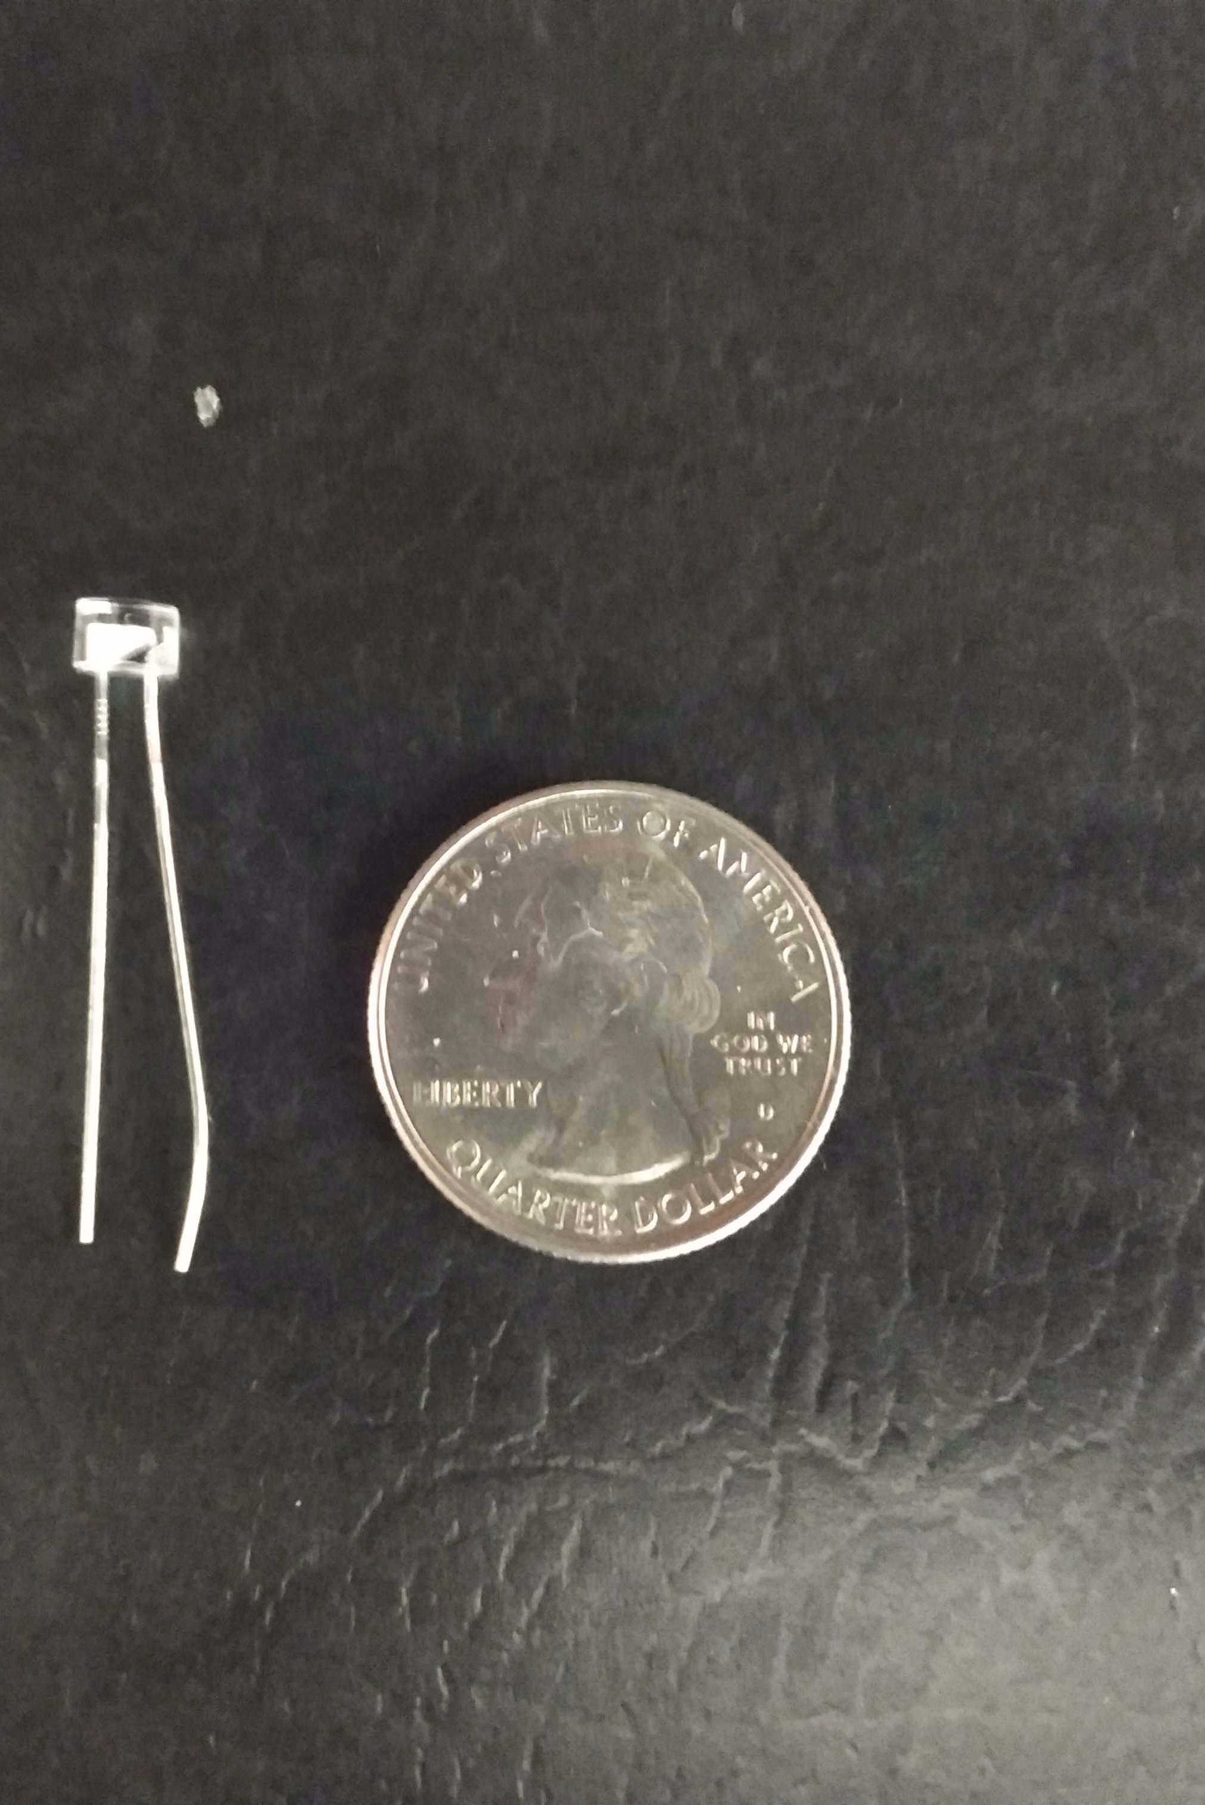
Everlight Sensor EAALST05RDMA0
Photoelectric diode better for us compared ambient light counterparts
Threshold levels allow distinction between low and optimal light levels
Purchased from Mouser for $0.70 per unit

Slide 15
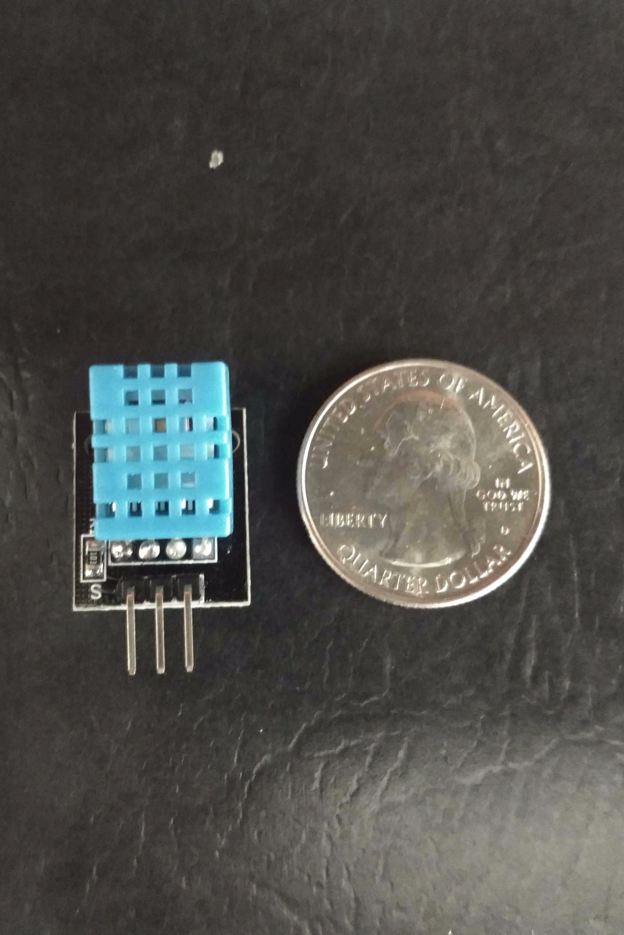
Temp and Humidity DHT11
Ultralow cost sensor reads temperature and humidity
Functions wide range of temperatures
Sampling rate of 1HZ
Low power use
Purchased from Amazon for 2.10 per unit

Slide 16
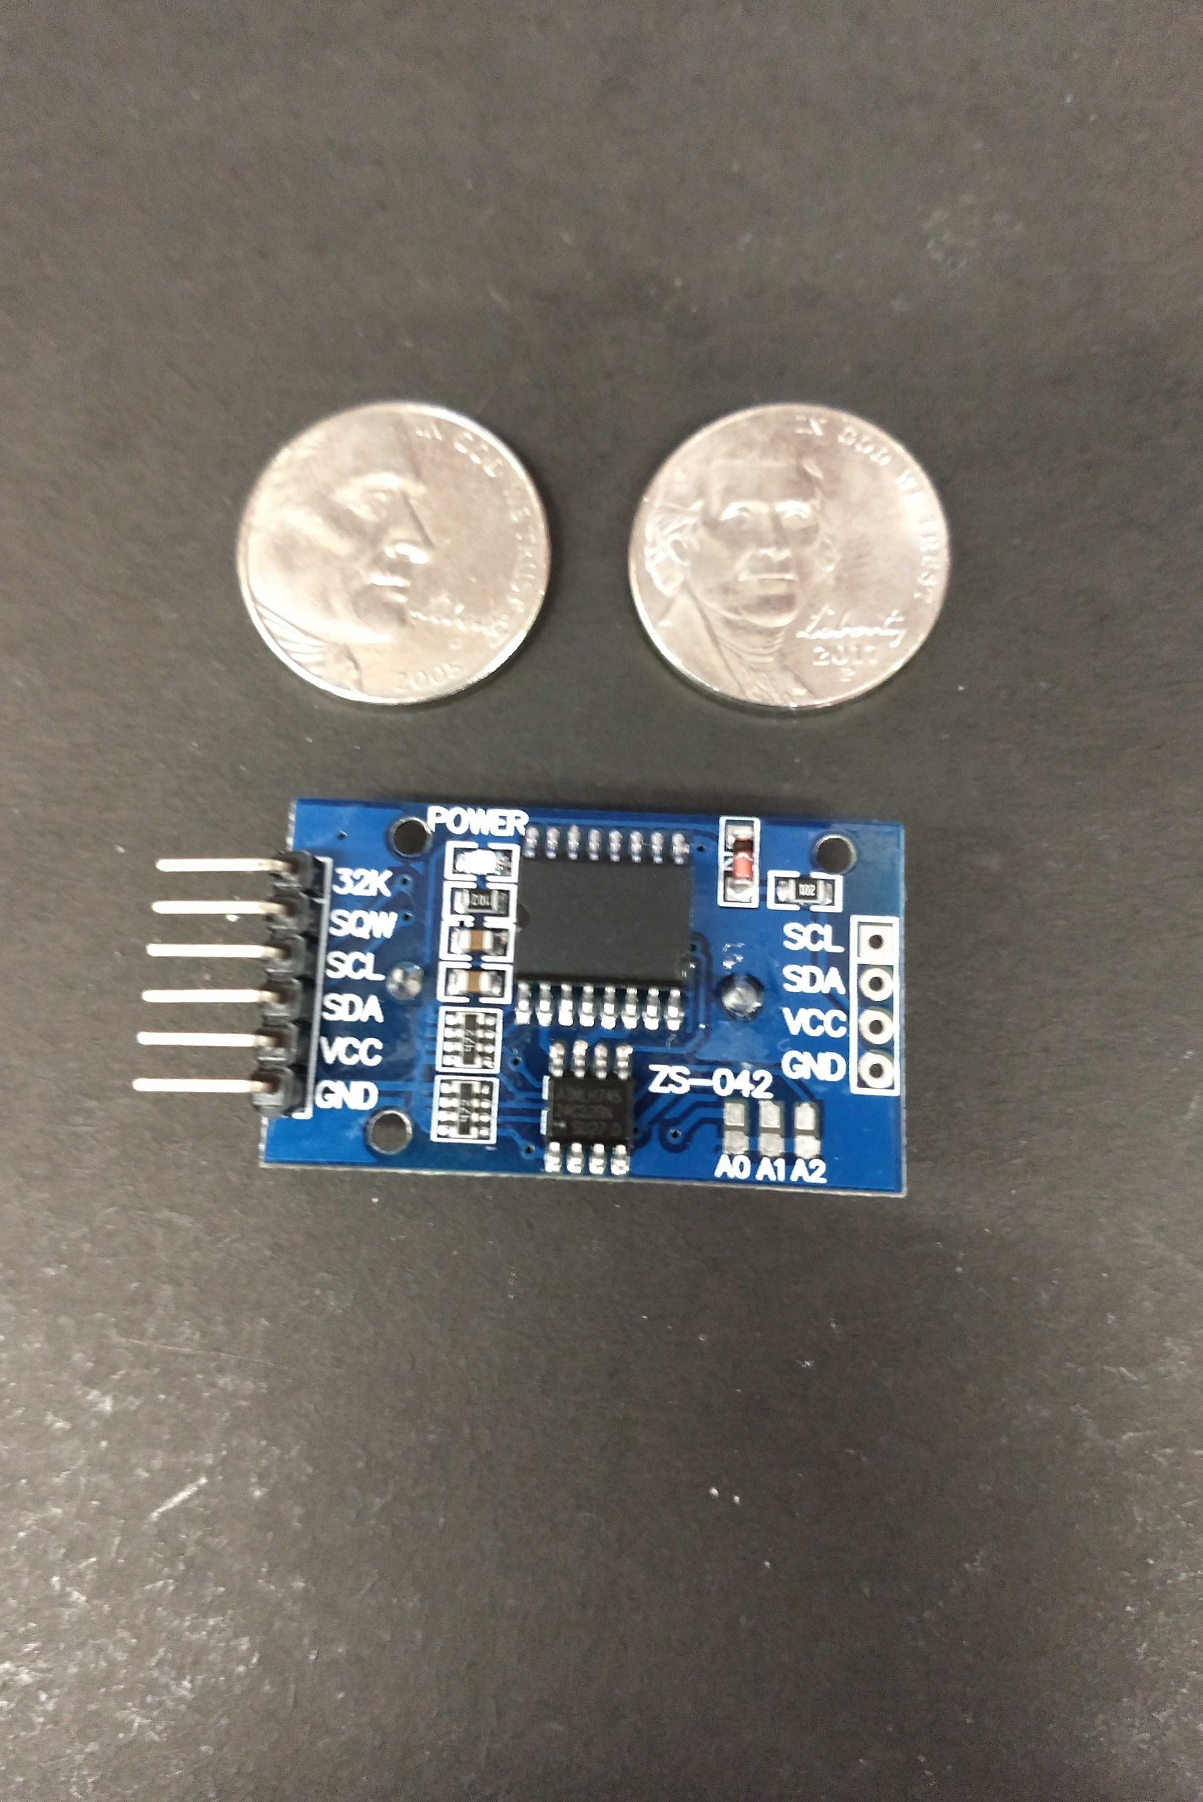
Real Time Clock DS3231
Used as a way of keeping accurate time passage
Low cost I²C module
Highly accurate and low drift
Independent of PCB timing elements

Slide 17
Wireless Technology Comparison
 | Wi-Fi | Zig-Bee | Bluetooth | GSM
Range | Up to 100m | 10m-100m | <100m | Ranges from over 100m to 35km
Cost | ~ $10-$30 | ~ $15-$20 | ~$10-$20 | Most Expensive ~ $150
Power Consumption | High Power Draw | Lowest Power Draw | Low Power Draw | Highest Power Draw
Data Transfer | Up to 55Mbps | 20-250Kbps | 1-3Mbps | 40-50Kbps

Slide 18
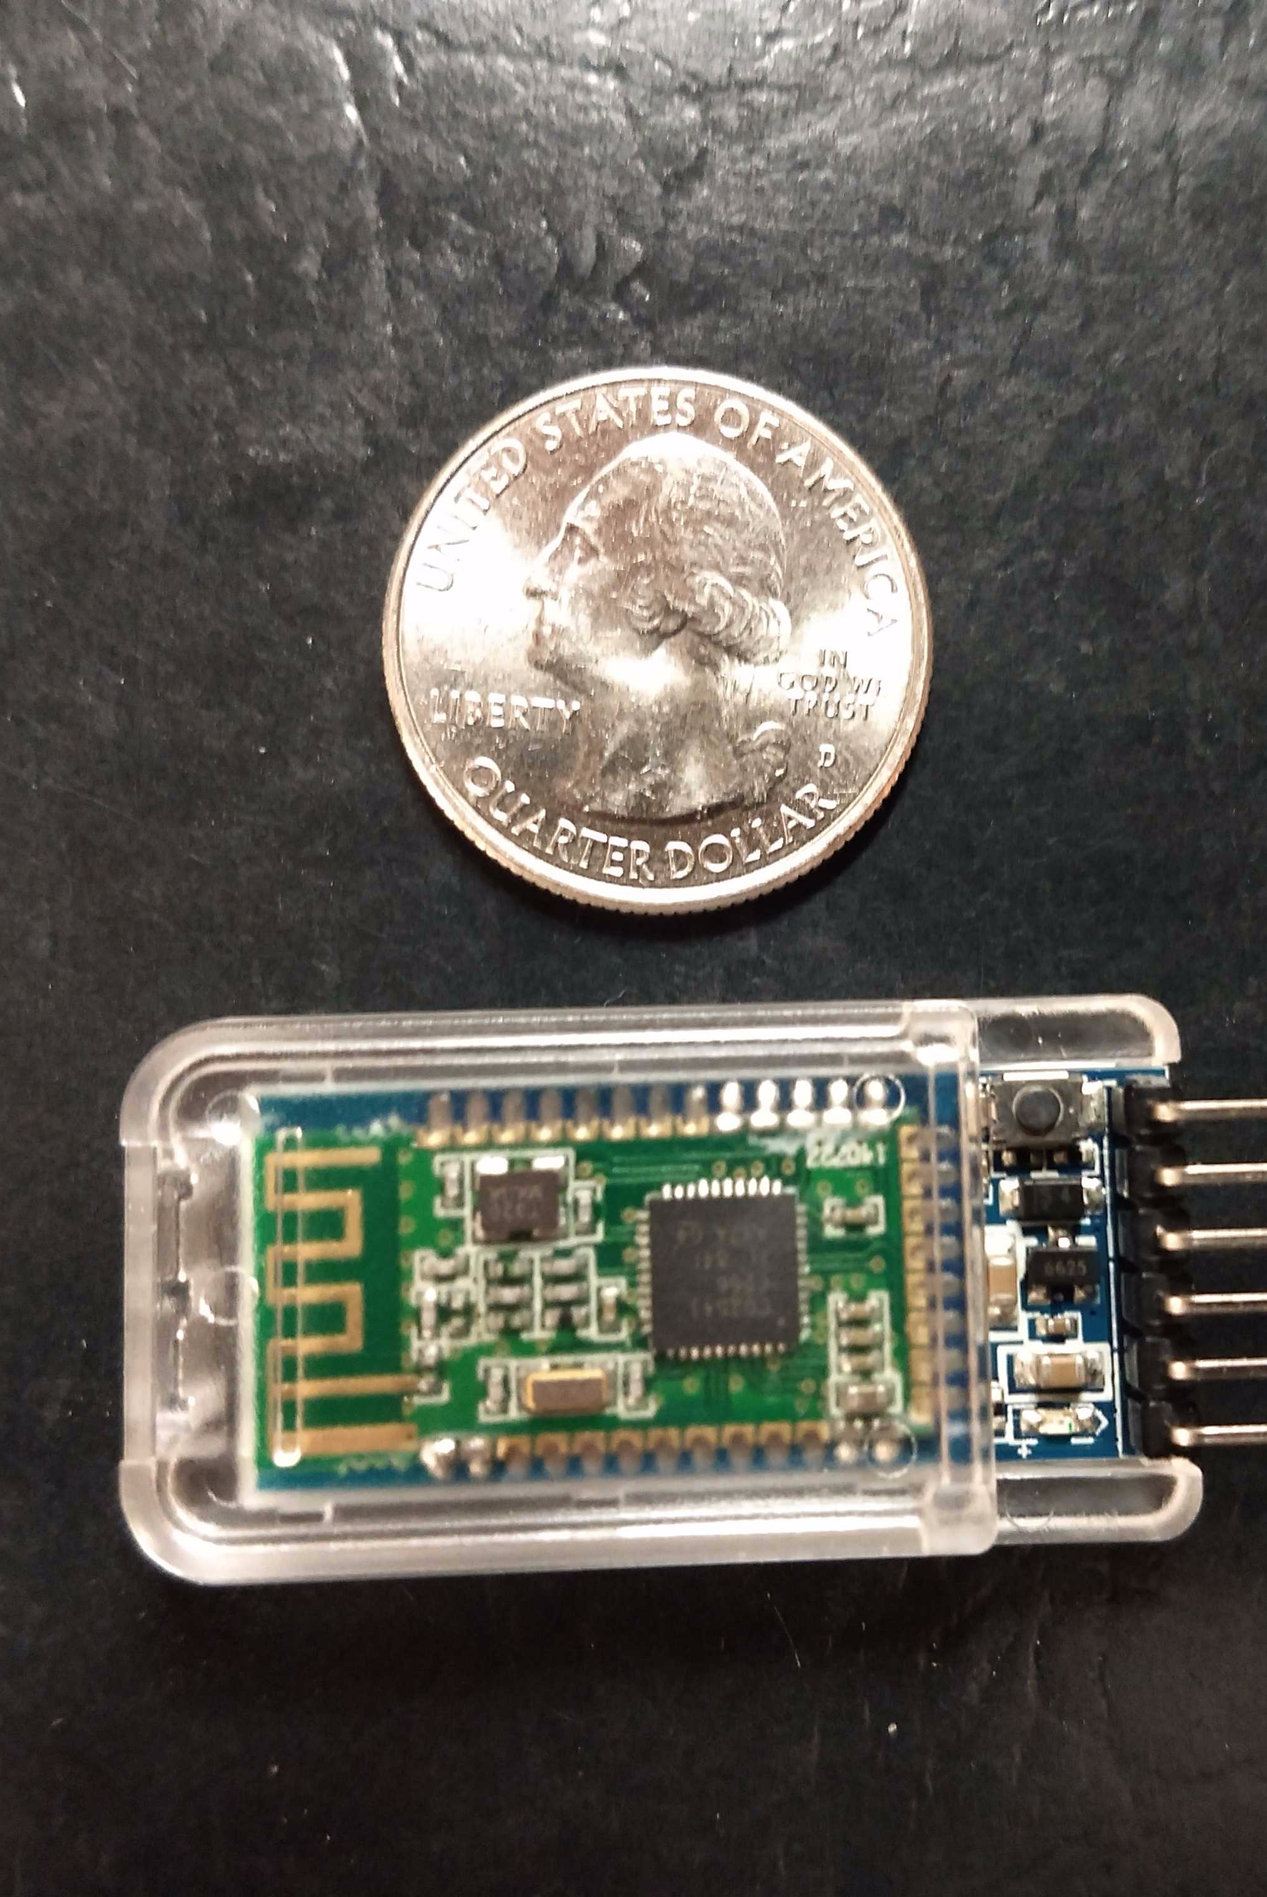
Wireless Module Choice HC-05
Transportation protocol chosen was Bluetooth SPP (Serial Port Protocol)
Moderate transfer rates, good broadcast distance, and low energy consumption
HC-05 utilizes UART for communication

Slide 19
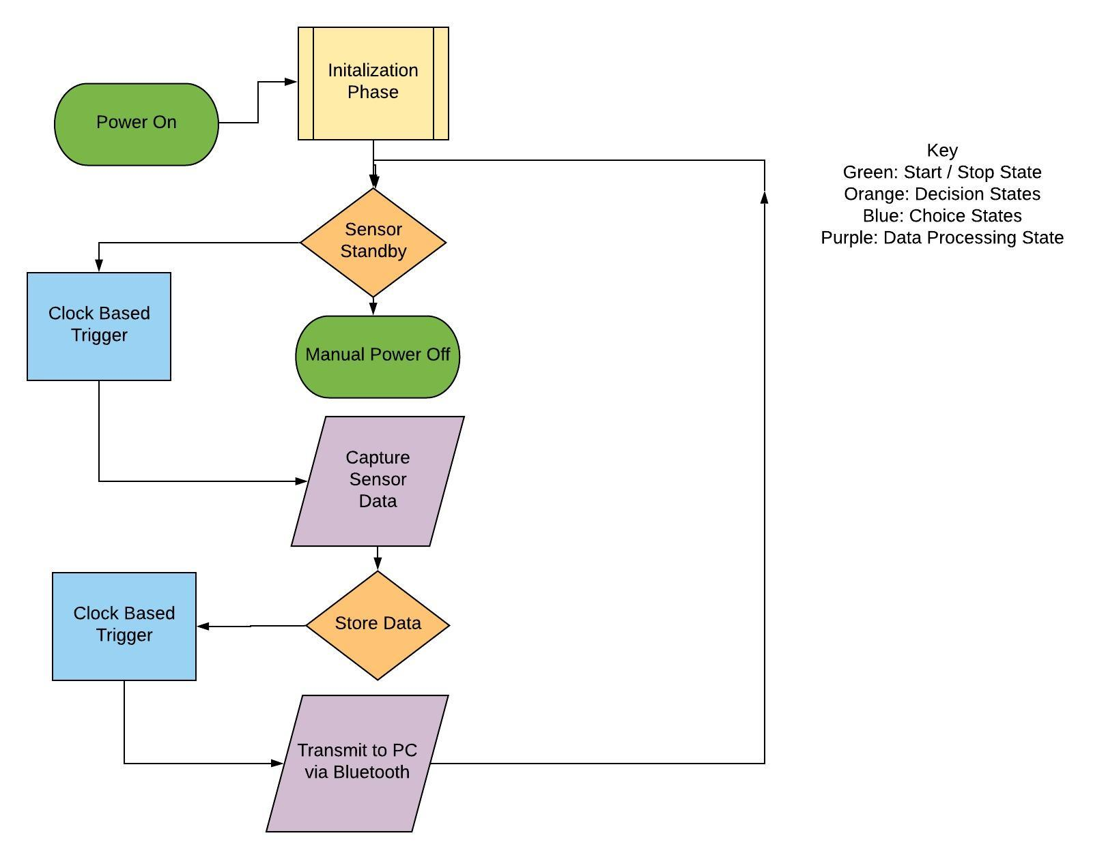
Embedded Software Flowchart

Slide 20
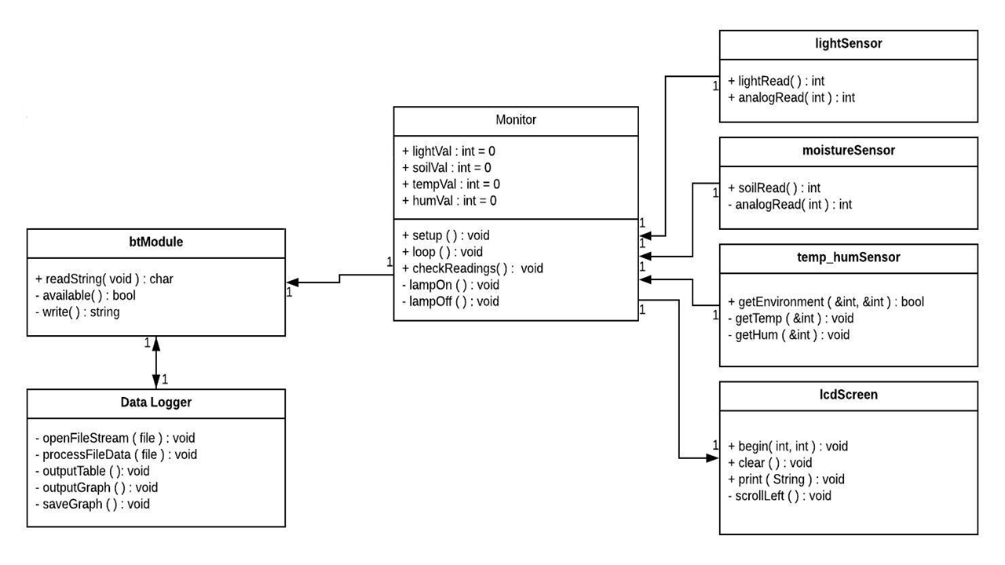
Class Diagram
Notes:
EDIT OUT SD CARD

Slide 21
Supporting Software
Identify trends that correlate plant growth with environment readings
Organize our data into graphical representations
Ability to identify inconsistencies in the environment
Prefer interpreted cross platform tools
Notes:
Alec

Slide 22
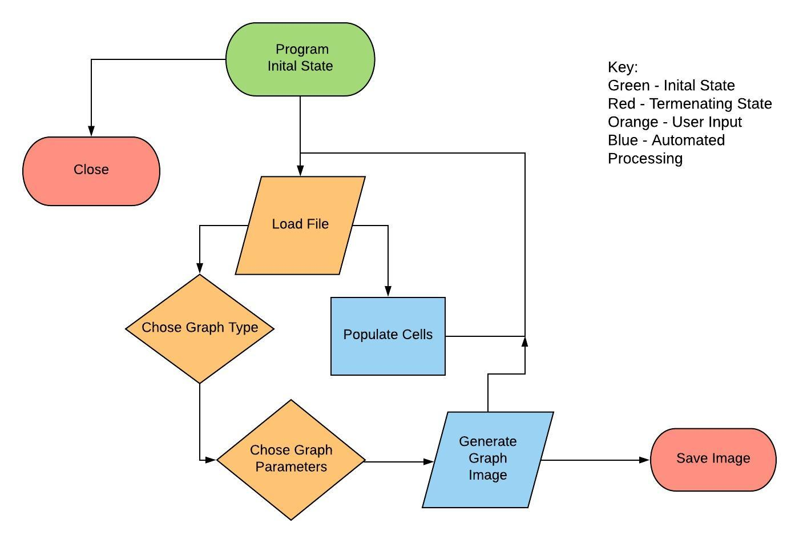
Support Software Flowchart
Notes:
Alec

Slide 23
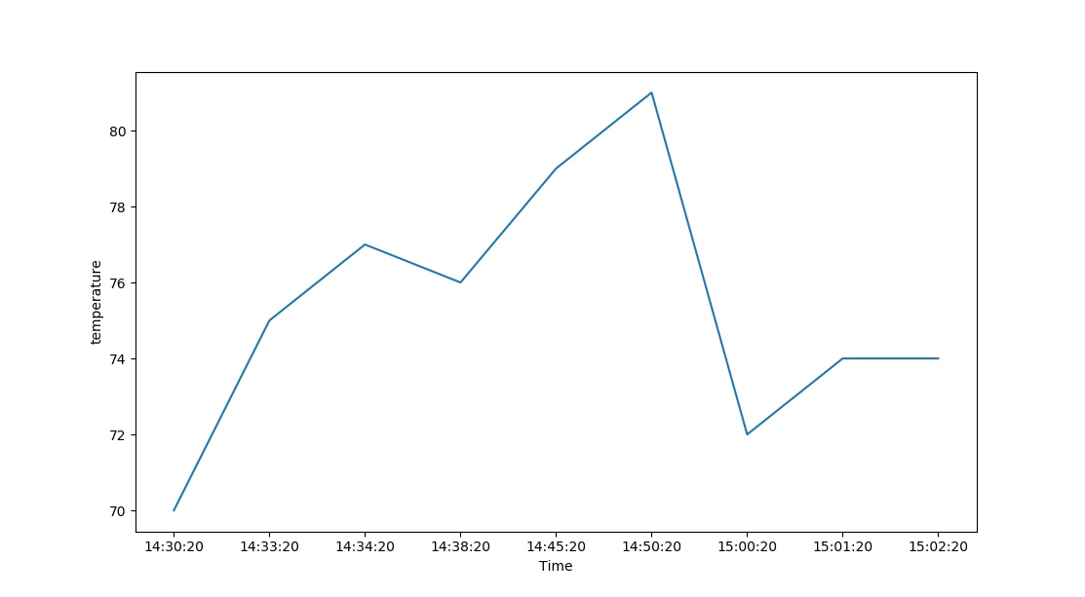
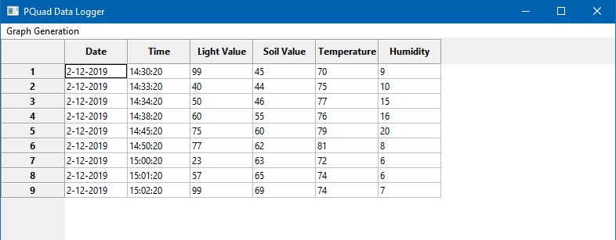
Data Graphing Tool
Wanted quick collections of data by category
Simple and clean interface with minimal points for confusion
Open source implemented in python and maintained using Git
Notes:
Alec

Slide 24
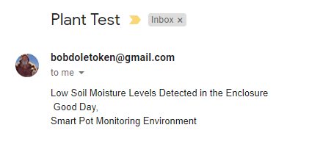
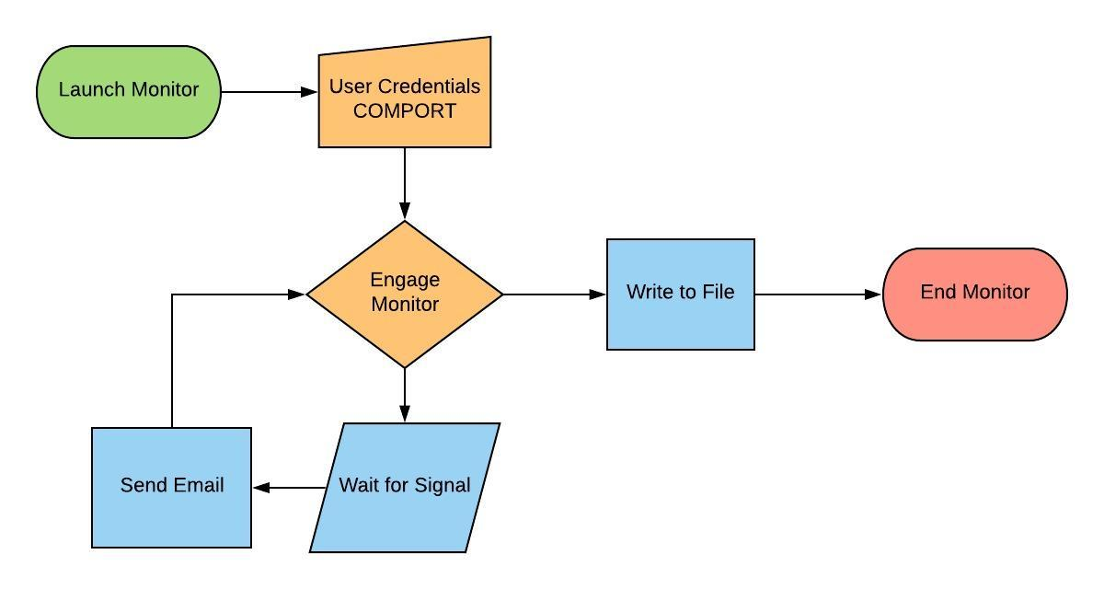
Monitor System
Lightweight system to inform user of unideal environmental conditions
Captures reading to file
Terminal based for ease of access
Cross-Platform Support
Notes:
Alec

Slide 25
Hardware Implementation
Notes:
Kareem

Slide 26
DC Power Supply
Keep the PCB running under all conditions
Is powered by an AC to DC adapter
Operational voltage range 5V-12V
Need a method to continue use after disconnecting from AC
Notes:
Kareem

Slide 27
Battery Back-up Circuit
9V battery is the back-up power supply
Allows the circuit to keep running after it is unplugged
Battery take-over features:
Automated switching
Easy battery replacement
Portability
Long running times
Notes:
Kareem

Slide 28
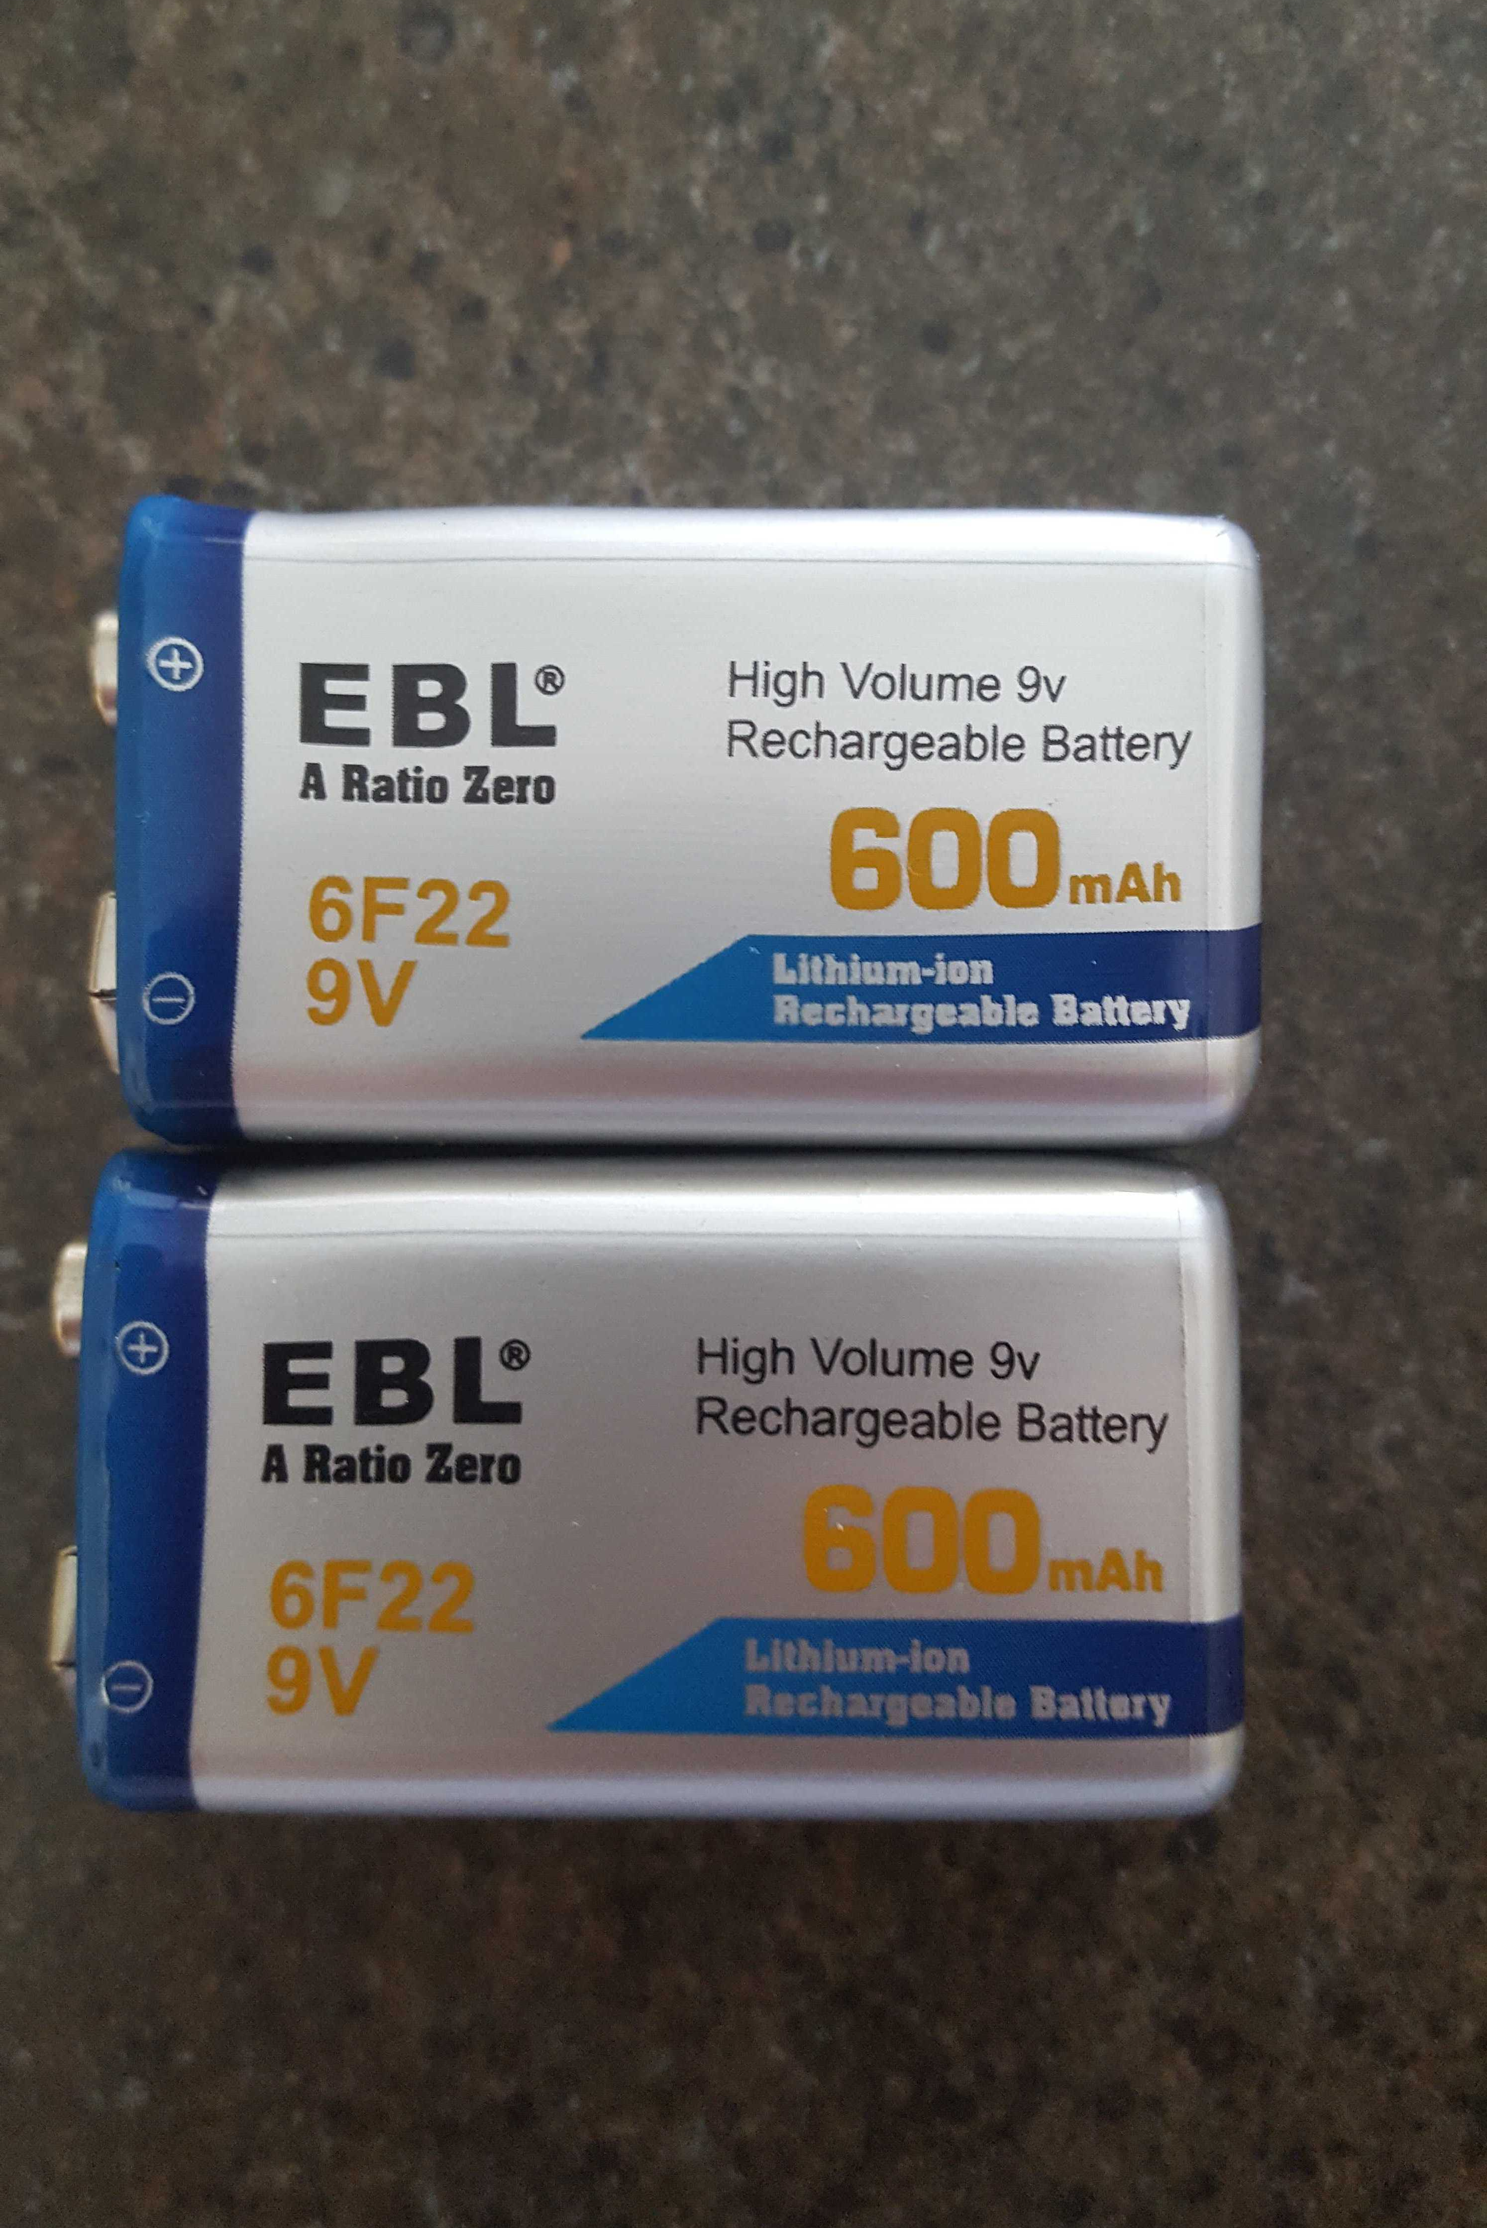
Battery Supply
9V Rating
Lithium ion composition
Rechargeable
Highly Cost Effective
Easily Substitutable
Notes:
Kareem

Slide 29
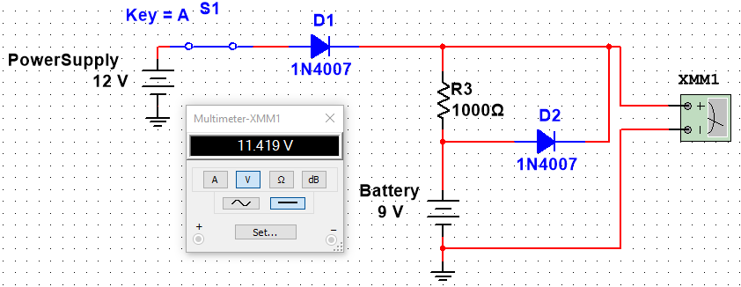
Closed Switch (Power Supply)
Notes:
Kareem

Slide 30
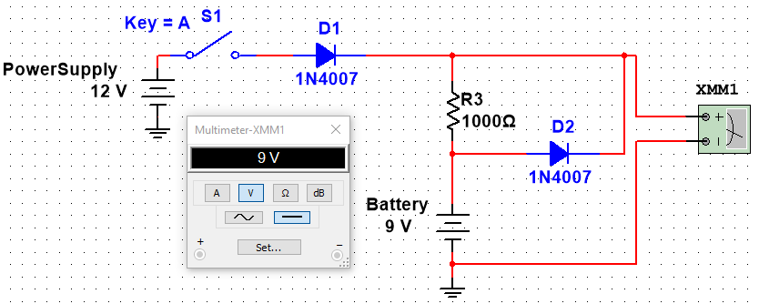
Open Switch (Battery Backup)
Notes:
Kareem

Slide 31
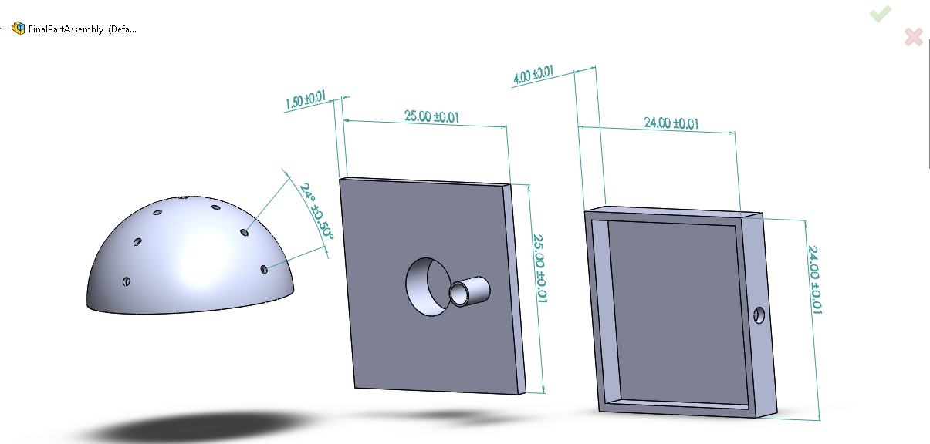
Enclosure Design
Notes:
Kareem

Slide 32
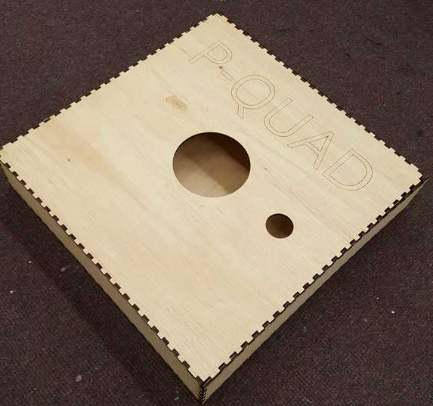
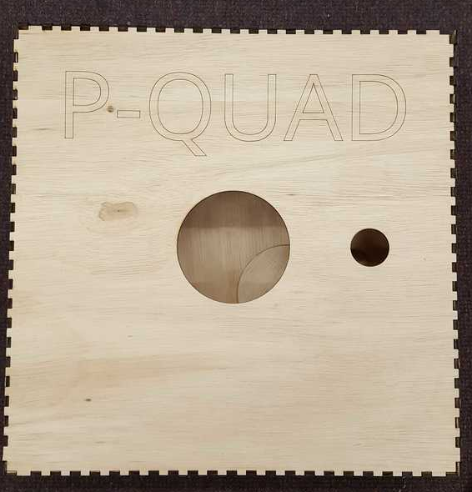
Enclosure
Notes:
Kareem

Slide 33
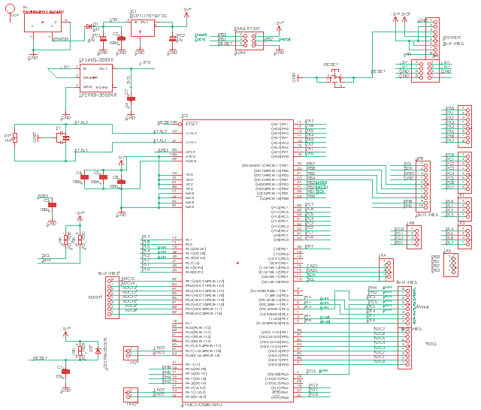
PCB Schematics
Notes:
Syed

Slide 34
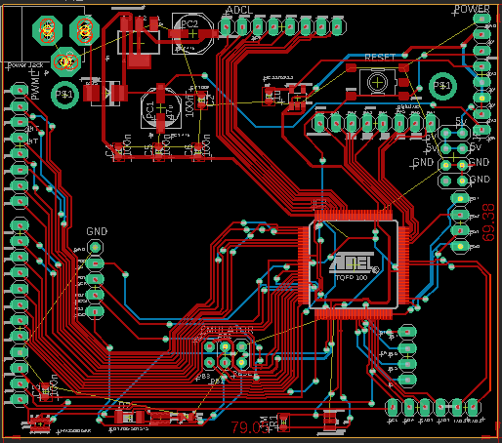
Full PCB
Notes:
Syed

Slide 35
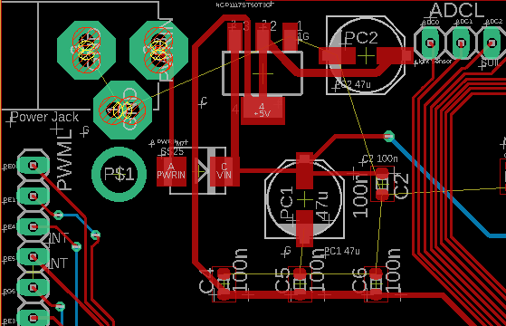
PCB Power Section

Slide 36
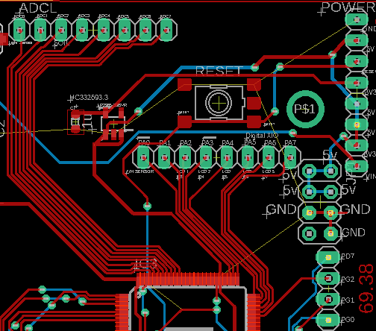
PCB Reset & Stepdown
Notes:
Syed

Slide 37
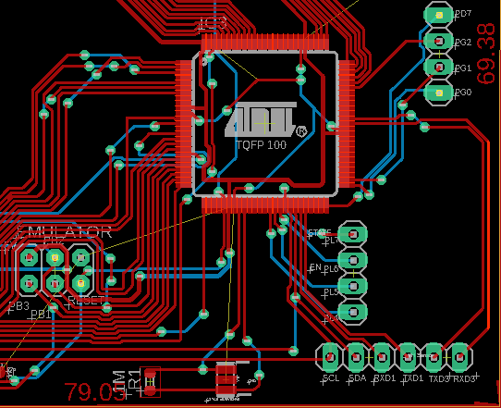
PCB MCU, ICSP, and Resonator
Notes:
Syed

Slide 38
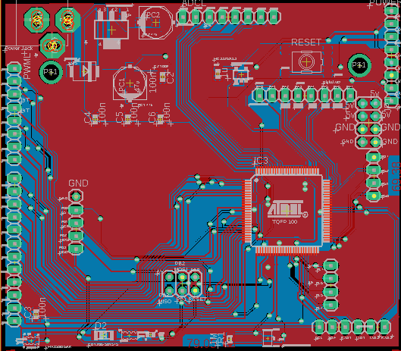
PCB Grounded Top Layer
Notes:
Syed

Slide 39
Administrative Content
Notes:
Alec

Slide 40
Work Distribution
Name/Section | Kareem | Nick | Alec | Syed
Embedded Logic |  | Secondary | Primary
Wireless Communications |  | Primary | Secondary
PCB Design | Secondary |  |  | Primary
Power System | Primary |  |  | Secondary
Supporting Softwares |  | Secondary | Primary
Enclosure Design | Primary |  |  | Secondary

Slide 41
IEC 60529 Standard
Degrees of protection against water ingress
Protection level at minimum is 2 (Protected against vertically falling water drops when enclosure tilted up to 15°) with a maximum level of 4 (Protected against splashing water )
Degrees of access to hazardous Parts
The level of protection provided for hazardous part protection is a 2, protection of hazardous parts from a finger or a solid foreign objects ≤ 12.5 mm diameter

Slide 42
Wireless Communication Standards Comparisons
Bluetooth SPP (Serial Port Profile)
Replaced RS-232
Very Common
Payload size 128B
~1W baseline usage
Bluetooth Low-Energy BLE
Low energy ~.1-.5W
Good for acknowledgments
Payload size 35B
Wireless LAN 802.11n
2.4 or 5GHz frequency
Low-Power draw ~1W
Average payload size 0<x<500B

Slide 43
Realistic Design Constraints
Switched from printed enclosure to wood
Change from PIC to ATMega MCU due to documentation limitation
Synchronizing transmission from embedded side to serial side of email notification system
Integration of humidity and temperature readings for accurate timing and integration into system
Issues with CAD software systems for later board iterations.

Slide 44
Project Budget
Expense | Estimated | Actual | Difference ($)
PCB | $ 50.00 | $ 61.68 | $ -11.68
CPU + Components | $ 35.00 | $ 59.04 | $ -24.04
Moisture Sensor | $ 80.00 | $ 45.42 | $ 34.58
Light Source | $ 40.00 | $ 15.50 | $ 24.50
LCD Display | $ 30.00 | $ 18.99 | $ 11.01
Enclosure | $ 70.00 | $ 42.79 | $ 27.21
Dev Kits | $ 40.00 | $ 31.99 | $ 8.01
RTC | $ 15.00 | $ 7.99 | $ 7.01
Power Supplies | $ 20.00 | $ 32.96 | $ -12.96
Bluetooth Module | $ 20.00 | $ 22.99 | $ -2.99
Plant | $ 10.00 | $ 11.99 | $ -1.99
Miscellaneous | $ 50.00 | $ 114.25 | $ -64.02
Total Expenses | $ 520.00 | $ 464.98 | $ 55.02

Slide 45
Bill of Material
Quantity | Part | Unit Price | Line Total | Quantity | Part | Unit Price | Line Total
2 | 2.1mm Barrel Jack | 1.625 | 3.25 | 2 | 16MHz Resonator | 0.315 | 0.63
2 | 47uF Cap | 1.255 | 2.51 | 2 | 47uF Cap | 1.435 | 2.87
1 | 1A Schottky Diode | 0.31 | 0.31 | 3 | LDO Regulator | 0.4967 | 1.49
1 | 2A Schottky Diode | 0.43 | 0.43 | 10 | 1A Switching Diode | 0.076 | 0.76
3 | 1uF Cap | 0.25 | 0.75 | 1 | MCU ATMEGA2560 | 10.65 | 10.65
10 | .1uF Cap | 0.005 | 0.05 | 1 | SD Card Slot | 6.59 | 6.59
10 | 1uF Cap | 0.105 | 1.05 | 1 | Bluetooth Module | 7.99 | 7.99
4 | LDO Regulator | 0.4025 | 1.61 | 1 | DHT11 Sensor | 5 | 5
10 | 150mA Switch Diode | 0.125 | 0.5 | 1 | SEN-13322 | 5.95 | 5.95
10 | Res Film Array 10k | 0.014 | 0.14 | 1 | EAALST05RDMA0 | 0.6 | 0.6
4 | 1A Schottky Diode | 0.3925 | 1.57 |  | Total | 44.4017 | 55.47
2 | 16MHz Resonator | 0.385 | 0.77
Notes:
NEED to update

Slide 46
Questions and Comments

